Slide 1

Lucky Pets
Computer Engineering
School of Informatics and Telecommunications
Puente Alto Headquarters
2024
Professor: Jeanette Leonelli
Capstone Section: 001D

Slide 2
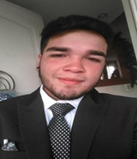
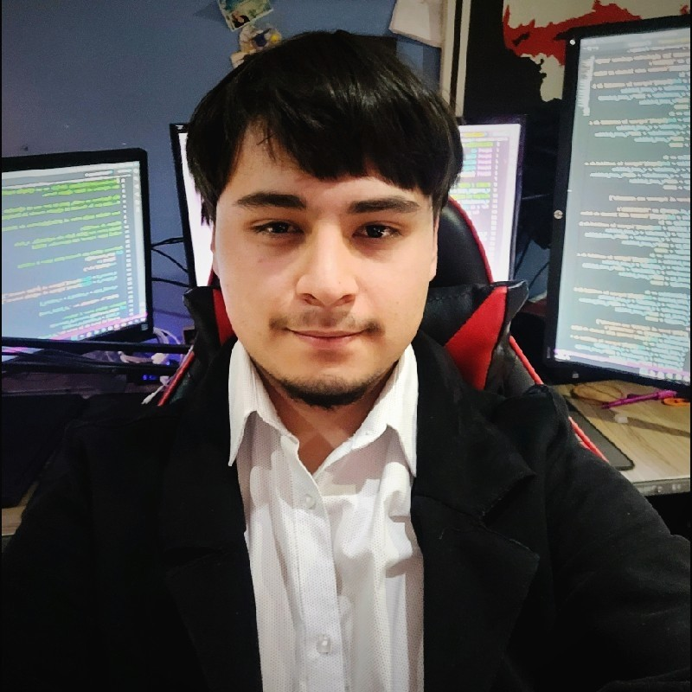

Patricio Fernandez
Position: Developer
Duties performed: Desktop application development
PROJECT MEMBERS
Benjamin Urrutia
Position : Team Leader and Developer
: Website development
Nicolas Varas
Position : Developer
Mobile application development

Slide 3
Project Description
Problem or pain
Description: Lack of safe and reliable vehicle transportation for pets and owners, this also includes:
1. Manage attentions
2. Medical records
3. Take trips
4. Information on pet health.
For veterinary clinics: Inefficient internal processes due to the absence of an integrated system that optimizes the management of:
1. Attentions
2. Reports
3. Billing
4. Data management.
Proposed solution
Description: Development of a comprehensive and accessible platform that allows scheduling appointments, managing medical records, receiving reminders and accessing detailed reports on the health of pets.
For veterinary clinics: Implementation of a system that optimizes internal administration, facilitates operational management and allows for effective technical support. This includes tools to manage care, records, billing and data analysis to improve decision making.

Slide 4
General Objective
Specific Objectives
Develop an integrated ecosystem of computer applications that includes a web application, a mobile application and a desktop application, in order to provide users with a fluid and accessible experience for the management and optimization of Animal Transport.
Develop an integrated ecosystem of computer applications that includes a web application, a mobile application and a desktop application, in order to provide users with a fluid and accessible experience for the management and optimization of Animal Transport.

Slide 5
Scope and limitations of the Project
What the System does:
User Login in different systems.
Take Trips.
Accept Trips.
Generate PDF and Excel Reports.
Register Users, Pets, Services, Clients, Affiliates, Drivers and Clinical Workers.
Modify Users and Service Statuses.
Delete Users.
Make Payments.
Subscribe.
What it doesn't do:
Be a mobile veterinary clinic.
Home care.
Sale of pet toys.
Sale of pet food.
Pet adoption.
Travel history.

Slide 6
Functional Requirements List
R.1 Login.
R.2 Customer Registration.
R.3 Travel History.
R.4 Register Pet.
R.5 Attach Form.
R.6 Book Trips.
R.7 External Payment.
R.8 Travel calculation.
R.9 Cash Payment.
R.10 Modify Customer Data.
R.11 Delete Customer Data.
R.12 Delete Pet Card.
R.13 Modify Pet File.
R.14 Pay Subscription.
R.15 Log Out.
R.16 Requests for attention.
R.17 State of attention.
R.18 Affiliate Clinic.
R.19 Recover password.
R.20 Cancel trip.
R.21 Modify trip.
R.22 Take a trip.

Slide 7
Non-functional requirements list
R.23 Compatibility.
R.24 Security
R.25 Reliability.
R.26 Performance.
R.27 Easy usability.
R.28 Scalability to updates.
R.29 Use company colors.
R.30 Responsive website.

Slide 8
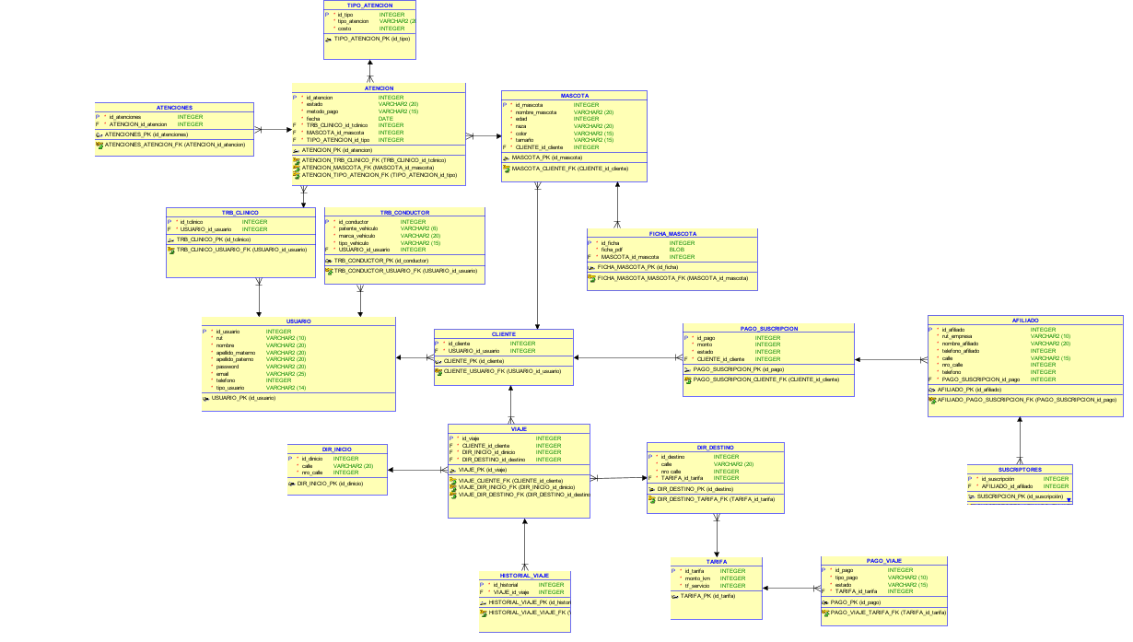
System design - relational database model

Slide 9
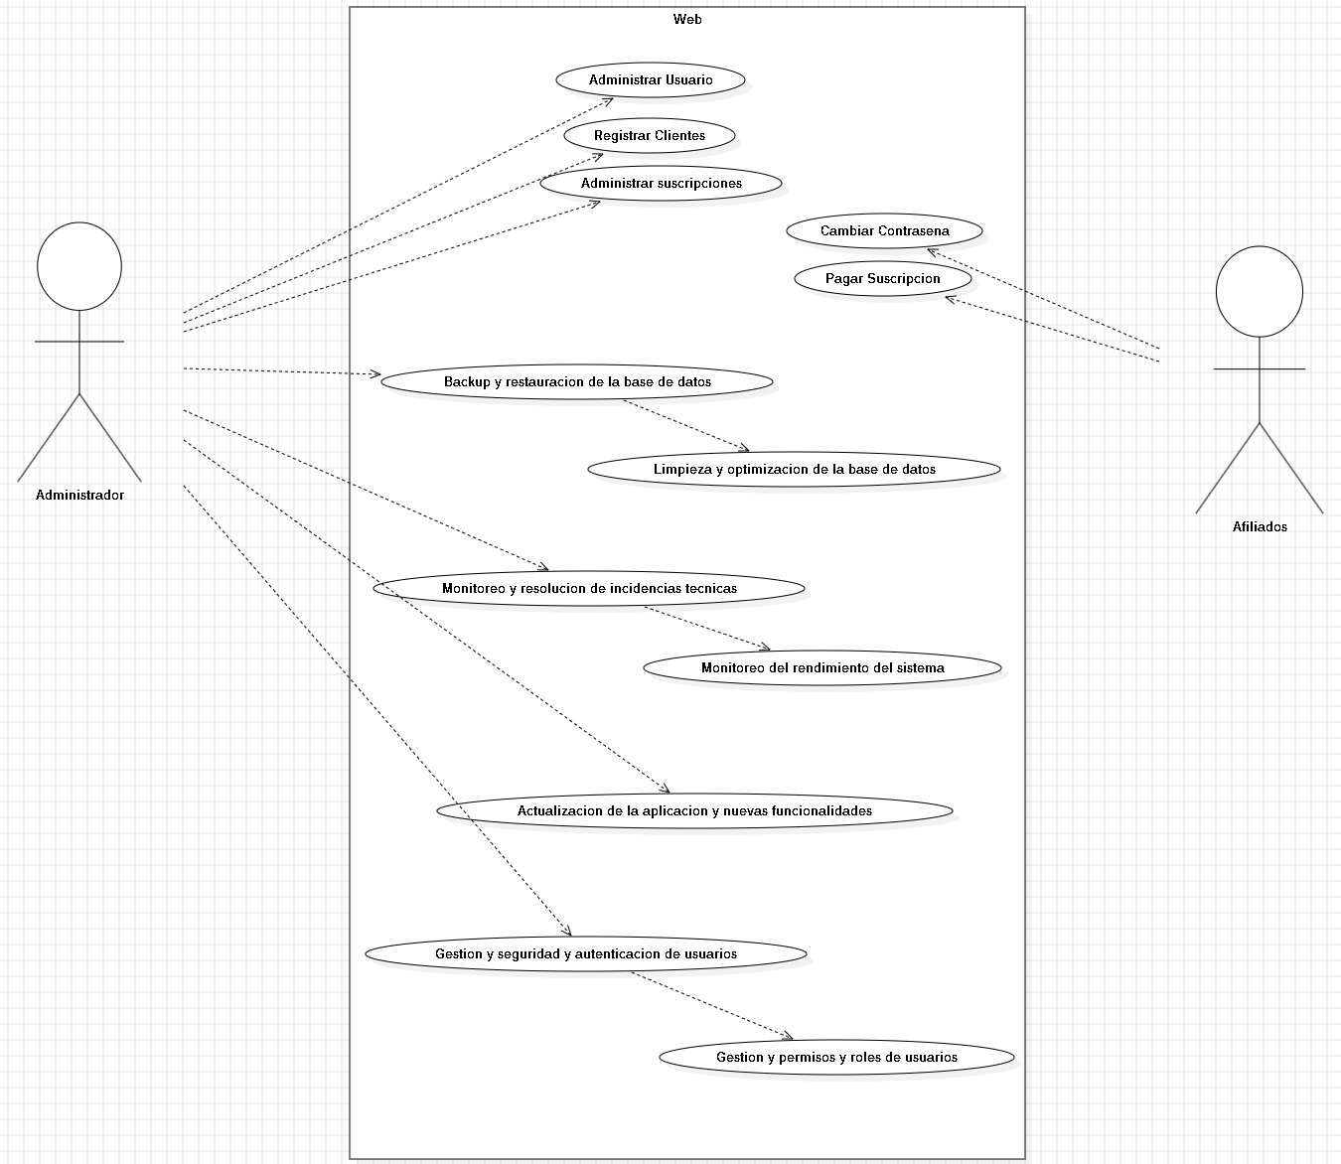
System Design - Use Case Diagram (WEB)

Slide 10
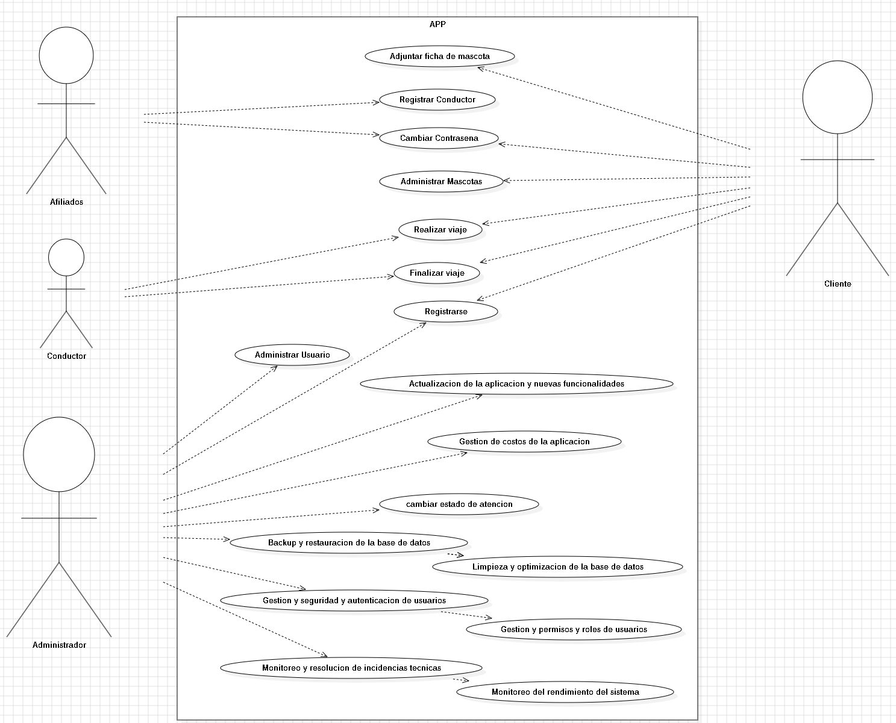
System Design - Use Case Diagram (APP)

Slide 11
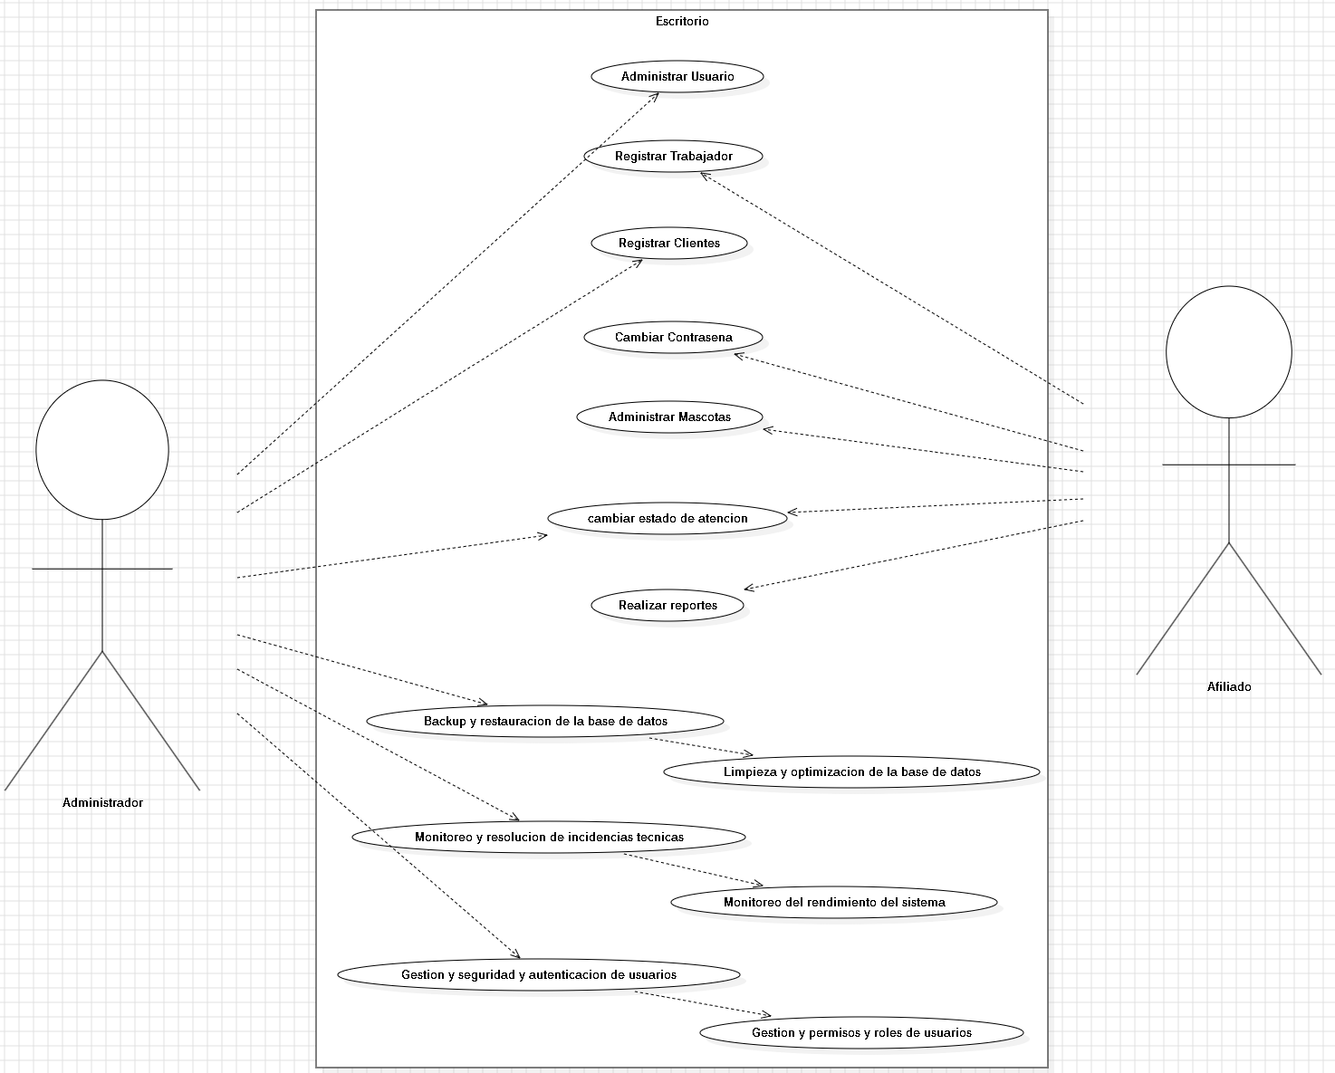
System Design - Use Case Diagram (Software)

Slide 12


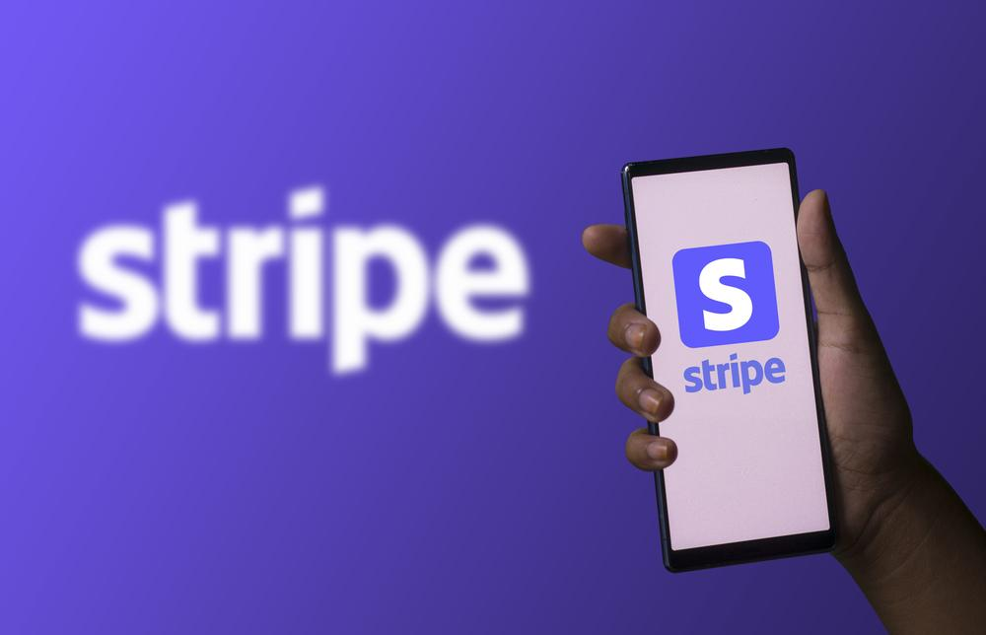



Development Technologies

Slide 13
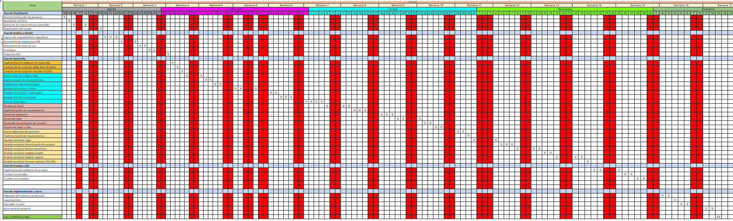
Planning - schedule with important project milestones

Slide 14
Development Test Plan
To check the correct functionality of the system, different tests were carried out based on the 3 systems developed (Web, Mobile and Desktop) and Database. For the latter case, different tests were carried out, including:
Tests Database:
Simultaneous Inserts - Concurrency Test
Bulk record upload
Insertion based on a query
Delete all records from a table
Delete a range of records from a table
Delete a range of records from a table and recover them with rollback
Update to a field
Update to a field - cascading
Insertion test while system is overloaded
Backup of the entire database
Backup restoration of the entire database

Slide 15
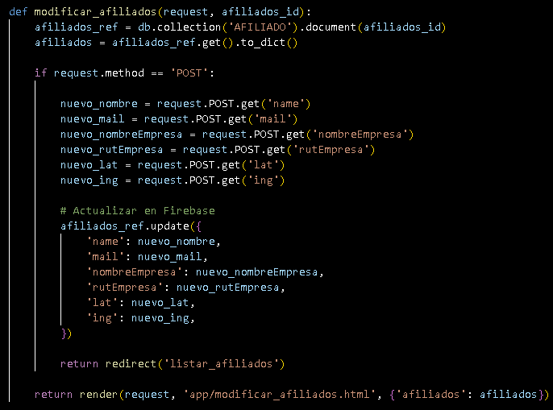
Development Test Plan
Tests Website:
Insert data into tables from a form
Modify table data through the web page
Delete data from tables via the web page
List data from tables through the web page
Managing users logged in to the website
Management of affiliated users who have made purchases on the website
Evidence

Slide 16
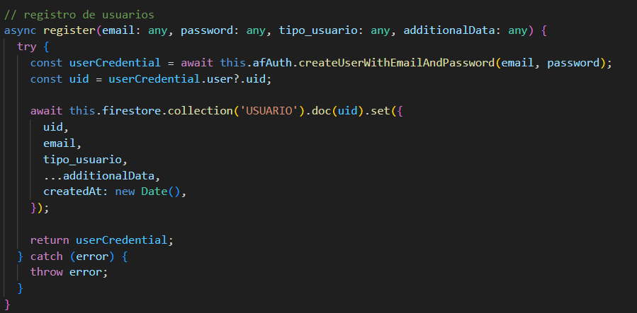
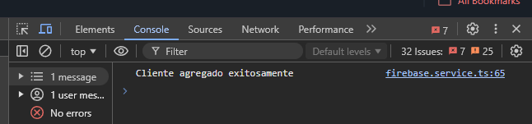
Development Test Plan
Mobile App Testing:
Testing User Data Insertion
Testing User Data Modification
Testing travel data insertion
Travel data deletion test
Travel data modification test
Travel data listing test
Geolocation taking test
Test of membership list (clinics)

Slide 17
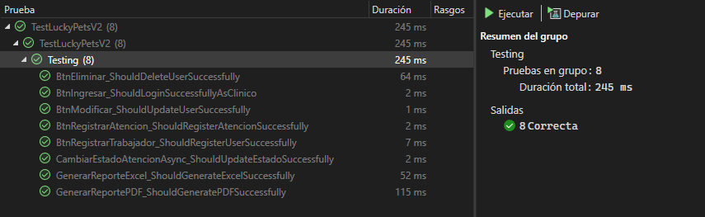
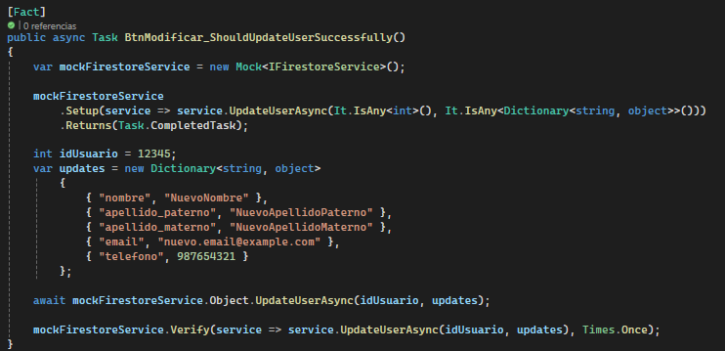
Development Test Plan
Desktop Software Testing:
Testing User Data Insertion
Testing User Data Deletion
Testing User Data Modification
PDF Report Generation Test
Excel report generation test
System Entrance Test
Proof of Care Record
Attention state modification test
EVIDENCE:

Slide 18



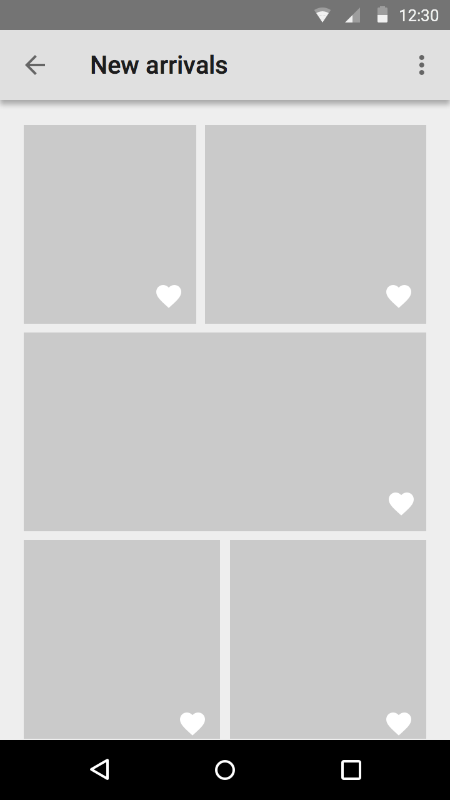
Sample of Systems

Slide 19
Final reflection
Lessons Learned and Obstacles Presented with the Experience.
What were the main obstacles you experienced as a team?
How would you avoid them for an upcoming project?
What were the most complex cases to develop?
Do you perceive a growth in your ability to develop real IT projects?
What were the main self-learnings you have achieved in the process?

Slide 20

Answer project questions

